Slide 1
Personal Finance
Mr. Desjarlais
Allatoona High School

Slide 2
Key Terms

Slide 3
Lesson 1: Budgets

Slide 4
Essential Question:
How do I create a budget?
How will I show I know it?
Be able to create a budget
Econ Agenda for Unit 3-1:
Review Unit 4 Test Results
Lesson 1 Notes
Today’s Activity:

Slide 5
Standards
SSEPF1 Apply rational decision making to personal spending and saving choices
Use a rational decision making model to evaluate the costs and benefits of post-high school life choices
Create a budget that includes a savings or financial investment plan for a future goal

Slide 6
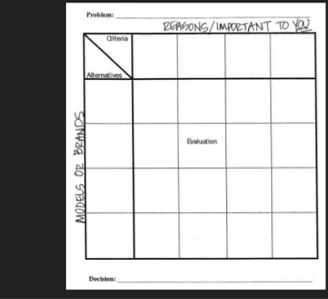
PACED Model
Using the PACED model can help you evaluate your post-high school life choices.

Slide 8
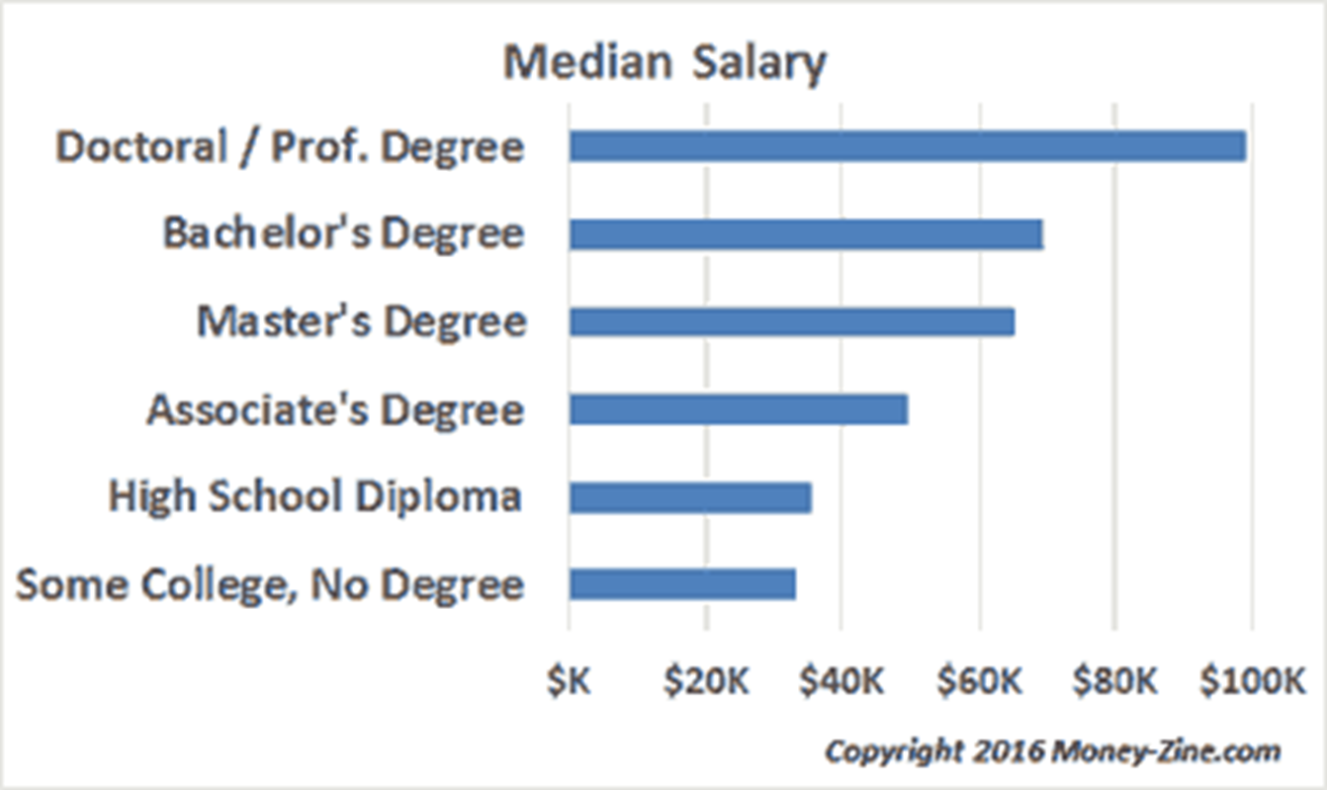
There is a direct relationship between the level of education of the Median Salary

Slide 10
Lesson 2: Financial Institutions
Notes:
Play this as kids enter
https://www.youtube.com/watch?v=EPrSVkTRb24

Slide 11
Essential Question:
- What are the different types of investment options?
How will I show I know it?
- Create a chart showing the different types of investment option
Econ Agenda for Unit 3-2:
Quick Assessment
Lesson 2 Notes
Today’s Activity:

Slide 12
Standards
SSEPF2 Explain that banks and other financial institutions are businesses that channel funds from savers to investors.
Compare services offered by different financial institutions, including banks, credit unions, payday lenders, and title pawn lenders.
Explain reasons for the spread between interest charged and interest earned.
Give examples of the direct relationship between risk and return.
Evaluate the risk and return of a variety of savings and investment options, including: savings accounts, certificates of deposit, retirement accounts, stocks, bonds, and mutual funds.

Slide 14
Banks
These are the most common
The offer a full range of services (Savings, Loans, CD’s ect)
Highly Regulated and Safe

Slide 16
Credit Unions
Very Similar to Banks
But Membership is Required

Slide 19
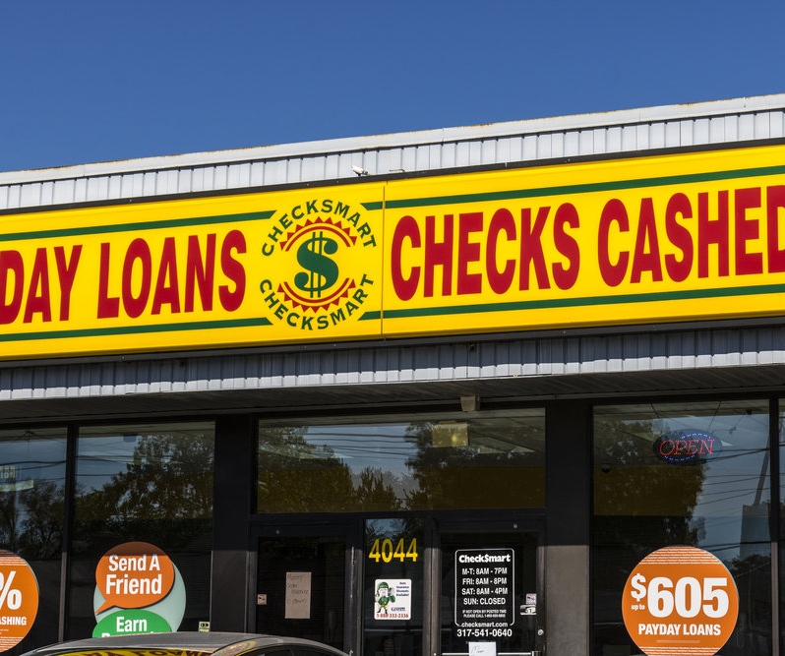
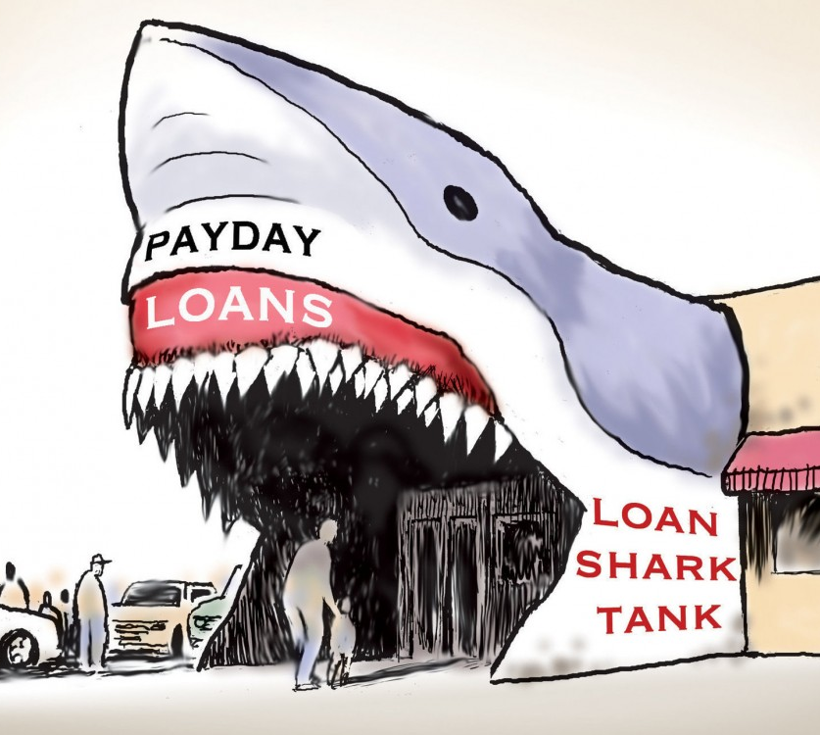
Payday Lenders/Title Pawn
Highly Risky
Insanely high interest rates
Often targets the poor or those with bad credit

Slide 20
Interest Earned Vs Charged

Slide 22
Risk/Return
There is an INVERSE relationship between risk and return
Risk is the likelihood that you will lose your money
Return is how much you may make on your investment
The Higher the risk, the Higher the Return and Vice-Versa

Slide 23
Types of Accounts Savings
Has the lowest rate of interest
Safe and insured by the Federal Government
You can remove funds whenever you want with no penalty

Slide 24
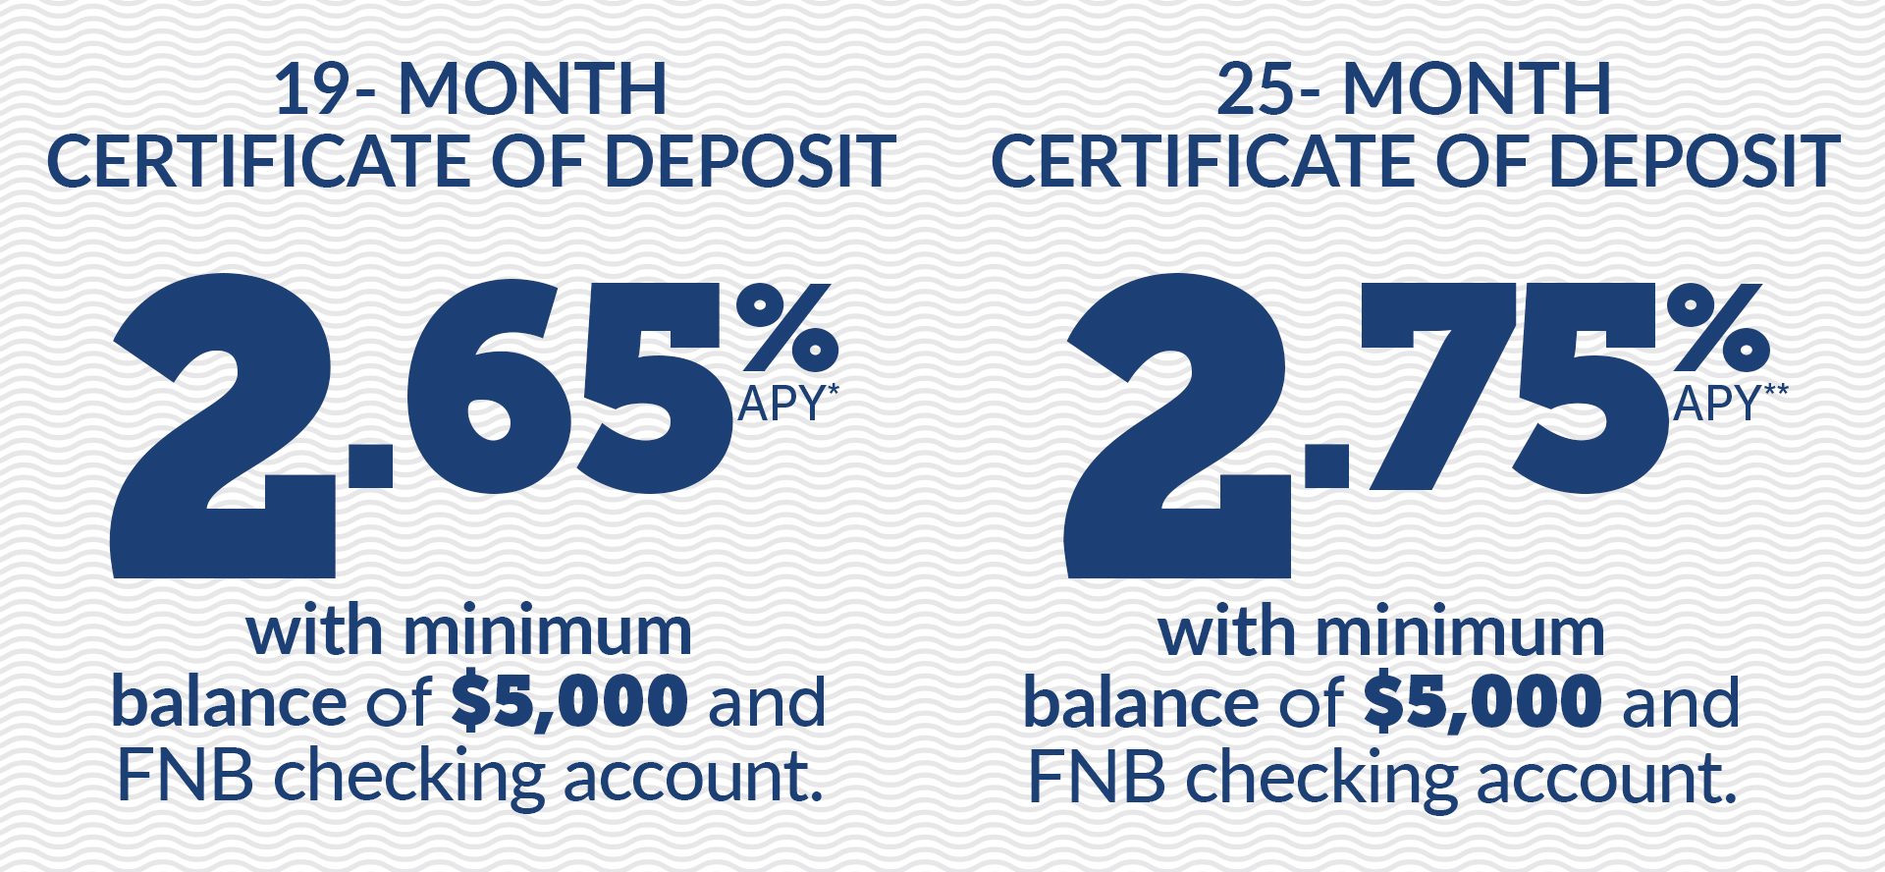
Types of Accounts CDs
A savings tool that allows you to invest money for a specific amount of time.
Usually periods are as little as 3-6 months to several years
High Interest than a savings account
Penalty for removing the funds early

Slide 25
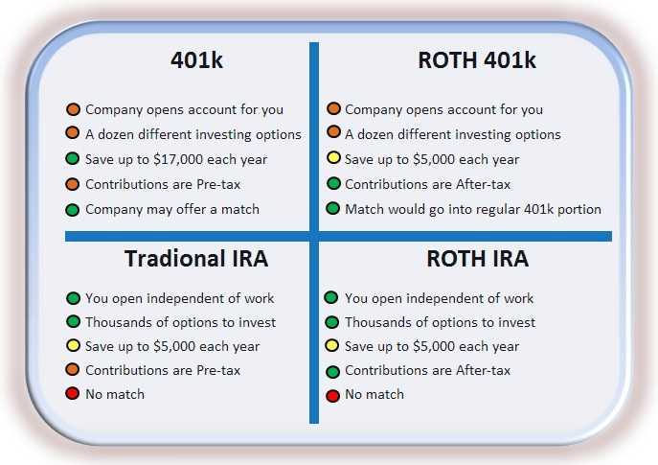
Types of Accounts Retirement

Slide 26
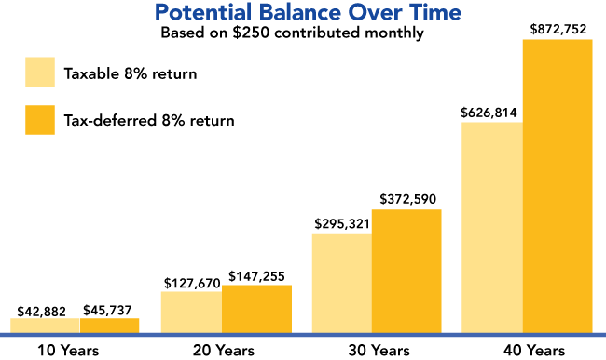
Types of Accounts Retirement

Slide 27
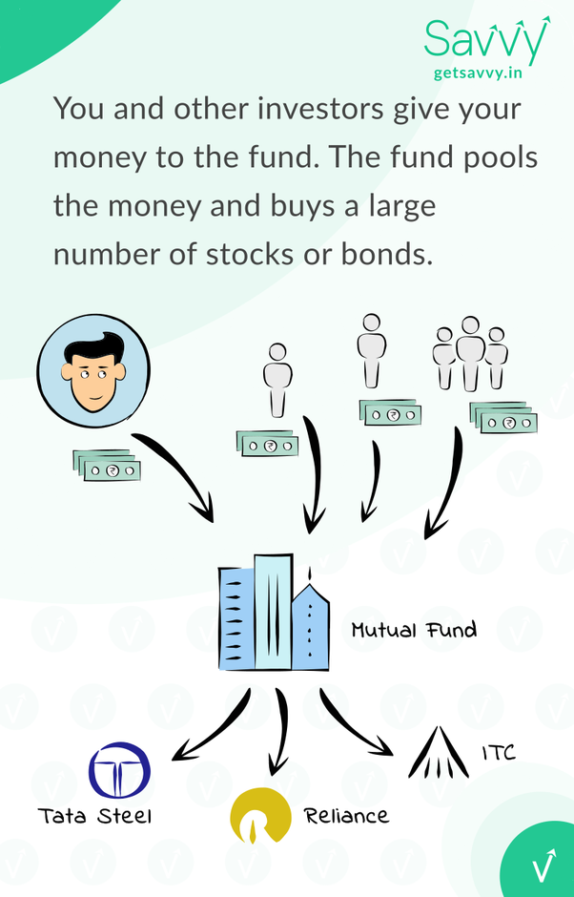
Types of Accounts Mutual Funds

Slide 28
Types of Accounts Bonds

Slide 29
Types of Accounts Stocks

Slide 30
Lesson 3: Taxation

Slide 31
Essential Question:
- How do changes in taxation have an impact on people?
How will I show I know it?
-Compare and contrast the different forms of taxation
Econ Agenda for Unit 3-3:
Quick Assessment
Lesson 3 Notes
Today’s Game:

Slide 32
Standards
SSEPF3 Explain how changes in taxation can have an impact on an individual’s spending and saving choices.
Define progressive, regressive, and proportional taxes.
Explain how an increase in sales tax affects different income groups.
Explain the impact of property taxes on individuals and communities.

Slide 33
Progressive Taxes
Those that have higher incomes, pay a higher % of the taxes
Example: Our current income tax

Slide 34
Regressive Taxes
Regressive taxes tax those with lower incomes more than those with high incomes
Example: Sales tax

Slide 35
Proportional Taxes
These tax groups at the same %
Example: Property Tax

Slide 36
Changes to the Sales Taxes
A increase in the sales tax hurts the poor more than it does the rich
A decrease in the sales tax help the poor more than it does the rich

Slide 37
Impact of Property Taxes
When property taxes increase, this can make certain area too expensive for the poor to afford them.
This process is often called gentrification.

Slide 39
Lesson 4: Credit

Slide 40
Essential Question:
What are the costs and benefits of using credit?
How will I show I know it?
Create a comparison chart showing the different rates for different types of credit cards.
Econ Agenda for Unit 5-4:
Quick Assessment
Lesson 3 Notes
Today’s Game:

Slide 41
Standards
SSEPF4 Evaluate the costs and benefits of using credit.
Describe factors that affect credit worthiness and the ability to receive favorable interest rates including character (credit score), collateral, and capacity to pay.
Compare interest rates on loans and credit cards from different institutions.
Define annual percentage rate and explain the difference between simple and compound interest rates, as well as fixed and variable interest rates.

Slide 42
What is Credit?
the ability of a customer to obtain goods or services before payment, based on the trust that payment will be made in the future.

Slide 43
Elements of Credit (3 C’s)
Character – What has been your repayment history (Credit Score)
Collateral – What you can either give up, or if you pay part of the cost up front (down paymant)
Capacity – Your ability to repay the loan. They will look at your income and savings.

Slide 44
Based on the following video
What is a credit score?
What is a good score?
What is a bad score?
What is one way to improve your score?

Slide 46
What type of card is for you?
What does Clark Howard say about how to use credit?
If you have trouble paying your bill what do you want in a card?
What about if you don’t have trouble paying your bill?
What else should you consider in a card?

Slide 48
Credit vs. Debit Cards
What are the Pro’s of Debit Cards?
What are the Con’s of Debit Cards?
What are the Pro’s of Credit Cards?
What are the Con’s of Debit Cards?

Slide 50
Interest
What is simple interest?
What is compound interest?

Slide 52
Lesson 5: Insurance

Slide 53
Essential Question:
How do people use insurance to protect the unexpected?
How will I show I know it?
Research different types of insurance rates
Econ Agenda for Unit 5-5:
Quick Assessment
Lesson 3 Notes
Today’s Game:

Slide 54
Standards
SSEPF5 Describe how insurance and other risk-management strategies protect against financial loss.
List and describe various types of insurance such as automobile, health, life, disability, and property.
Explain the costs and benefits associated with different types of insurance, including deductibles, premiums, shared liability, and asset protection.

Slide 55
Insurance
Insurance is a tool that you can buy that protects you and your family against unexpected events.
Types
Automobile (protects your car/bike)
Health (if you get sick)
Life (if you die)
Disability (if you get hurt and cant work)
Property (your home/apartment)

Slide 56
Costs
Premium – The amount YOU pay just to have the insurance.
Deductible – How much you must pay BEFORE the insurance pays
Claim - the total amount that you are being charged because of an event
There is an INVERSE relationship between Premium and Deductible

Slide 57
Example
You have and auto accident on your car which costs $4400
$4400 is your claim
Your deductible is $1000
Therefore, you pay $1000, the car insurance pays $3400

Slide 58
Other factors
Other Factors can influence the premium
Age
Health
Area you live in
The type of car
The type of house
Your credit

Slide 59
Benefits
The two major benefits of insurance is shared liability and asset protection
Shared liability means that if something happens you don’t have to pay for it entirely
Asset protection means that your stuff is protected

Slide 60
Lesson 6: Workers Earnings

Slide 61
Essential Question:
How are the earnings of workers determined in the market?
How will I show I know it?
Create a chart showing different jobs and their current earnings.
Econ Agenda for Unit 5-6:
Quick Assessment
Lesson 3 Notes
Today’s Game:

Slide 62
Standards
SSEPF6 Describe how the earnings of workers are determined in the marketplace.
Identify skills that are required to be successful in the workplace, including positive work ethics, punctuality, time management, teamwork, communication skills, and good character.
Explore job and career options and explain the significance of investment in education, training, and skill development as it relates to future earnings.

